Slide 1
Digital Electronics
Principles & Applications
Fifth Edition
Roger L. Tokheim
Chapter 10
Arithmetic Circuits
©1999 Glencoe/McGraw-Hill

Slide 2
CHAPTER 10 PREVIEW
Binary Addition
Half & Full Adders
Binary Subtraction
Half & Full Subtractors
Parallel Adders and Subtractors
Using Adders for Subtraction
Binary Multiplication
Binary Multipliers
Half & Full Adders
2s Complement

Slide 3
BINARY ADDITION
Conceptually similar to decimal addition
Example: Add the binary numbers 1010 and 11
(carry)
1
1 0 1 0
+ 1 1
1
1
0
1

Slide 4

TEST
Add the Binary numbers 11010 and 1100
(carry)
1
(carry)
1
1 1 0 1 0
+ 1 1 0 0
1
0
0
1
1
0

Slide 5
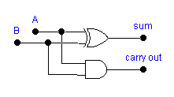
HALF ADDER
Logic device that adds two binary numbers
Only adds Least Significant Digit (LSD) column (1s column) in binary addition
Input Output
Logic Symbol:
A
Half
Adder
Σ (sum)
B
C₀ (carry out)
Logic Diagram:

Slide 6
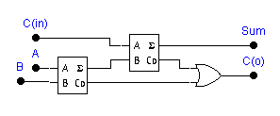
FULL ADDER
Used for adding binary place values other than the 1s place
Input Output
Logic Symbol:
C_{in}
Full
Adder
Σ (sum)
A
B
C₀ (carry out)
Logic Diagram:

Slide 7
BINARY SUBTRACTION
Example: Subtract binary number 101 from 1011
(borrow)
0
1
1 0 1 1
- 1 0 1
0
1
1
0

Slide 8
TEST
Subtract binary number 11 from 1010
01
0
10
1
0
1
1 0 1 0
- 1 1
0
1
1
1

Slide 9
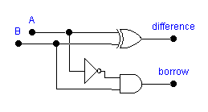
HALF SUBTRACTOR
Subtracts LSD column in binary subtraction
Input Output
Logic Symbol:
A
Half
Subtractor
D_{i} (difference)
B
B₀ (borrow out)
Logic Diagram:

Slide 10
FULL SUBTRACTOR
Used for subtracting binary place values other than the 1s place
Input Output
Logic Symbol:
B_{in}
D_{i} (difference)
Full
Subtractor
A
B
B₀ (borrow out)
Logic Diagram:
B_{in}
D_{i}
H. S.
A
B₀
H. S.
B

Slide 11
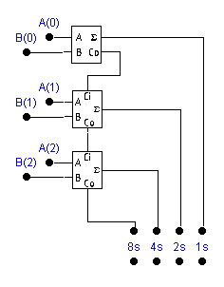
PARALLEL ADDING
Use half adder for LSD
Use full adder for other digits
A₂ A₁ A₀
+ B₂ B₁ B₀

Slide 12
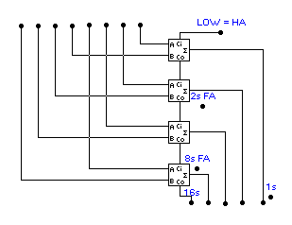
PARALLEL ADDER
Enter binary numbers
to be added here
0 0 1 1 + 1 0 0 0
1 1 1 0 + 0 1 1 0
1 1 0 0 + 1 1 1 1
1 1 0 1 1
1 0 1 0 0
0 1 0 1 1
SUM appears here
1s place uses half-adder
2s, 4s, 8s places use full adders
Parallel adders are available in IC form.

Slide 13
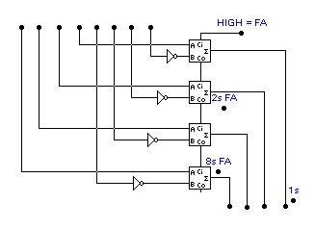
PARALLEL SUBTRACTOR USING FULL ADDERS
HIGH at Carry in input acts like adding +1 to a 1s C number to form the 2s complement.
1sC is formed by four inverters.
HIGH at Carry in input makes this perform as a full adder circuit
Binary numbers to be subtracted are input here
1 0 0 1 - 0 1 1 1
1 1 1 1 - 0 0 1 1
Note the use of four full adder circuits
Also notice the addition of four inverters on the B inputs to the FAs
1 1 0 0
0 0 1 0
Inverters
The result (difference) of the subtraction problem will appear here.

Slide 14
BINARY MULTIPLICATION
Example: Multiply the binary numbers 111 and 101.
1 1 1
x 1 0 1
Multiplicand
Multiplier
1
1
1
1st partial product
0
0
0
2nd partial product
1
1
1
3rd partial product
1
0
0
0
1
1
Product
111 x 101 can also be calculated: 111 + 111 + 111 + 111 + 111

Slide 15
TEST
Multiply the binary numbers 101 and 100.
1 0 1
x 1 0 0
0
0
0
0
0
0
1
0
1
1
0
1
0
0

Slide 16
BINARY MULTIPLIERS
Binary multiplier circuits - utilize repeated addition.
Block Diagram:
Multiplicand
register
Adder
Multiplier
down counter
Product
register

Slide 17
2s COMPLEMENT NOTATION
2s complement representation - widely used in microprocessors.
Represents sign and magnitude
MSB
LSB
Sign bit (0 = + ; 1 = -)
Decimal: +7 +4 +1 0 -1 -4 -7
2s Complement: 0111 0100 0001 0000 1111 1100 1001

Slide 18
2s COMPLEMENT - CONVERSIONS
Converting positive numbers to 2s complement:
  Same as converting to binary
Converting negative numbers to 2s complement:
Decimal to 2s Complement
2s Complement to
Binary
- 4 (decimal)
1 1 0 0 (2s C)
Convert decimal
to binary
1s complement
0 1 0 0
1s complement
0 0 1 1
1 0 1 1
Add 1
Add 1
- 4 = 1 1 0 0 (2s Complement)
0 1 0 0 (Binary)

Slide 19
ADDING/SUBTRACTING IN 2s COMPLEMENT
2s complement notation makes it possible to add and subtract signed numbers
(Decimal)
2s Complement
(- 1)
+ (- 2)
1 1 1 1
+ 1 1 1 0
(- 3)
1
1
1
0
1
2s complement
Discard
(+1)
+ (- 3)
0 0 0 1
+ 1 1 0 1
(- 2)
1
1
1
0
2s complement

Slide 20
TEST
Add the following 2s complement numbers:
(+5)
+ (- 4)
0 1 0 1
+ 1 1 0 0
(+1)
1
0
0
0
1
Discard

Slide 21
PRACTICAL SUGGESTION FOR BINARY MATH
Use a scientific calculator.
Most scientific calculators have DEC, BIN, OCT, and HEX modes and can either convert between codes or perform arithmetic in different number systems.
Most scientific calculators also have other functions that are valuable in digital electronics such as AND, OR, NOT, XOR, and XNOR logic functions.

